Slide 1
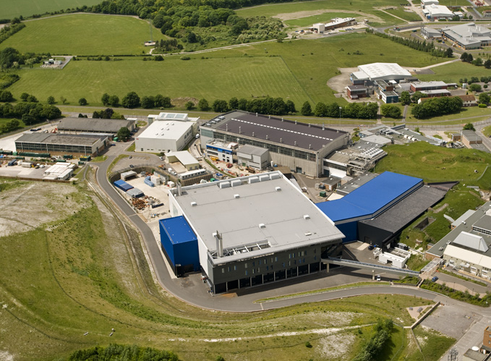
PACE: A framework for distributed data analysis of inelastic neutron spectra
PACE
T. G. Perring, A. Buts, M. D. Le,
R. Fair, D. Jochym.

Slide 2
Proper Analysis of Coherent Excitations
Data analysis as an integral part of the instrument
Organised as an instrument upgrade project.
Integrated visualisation, simulation and fitting environment on a distributed computing platform.
Goals:
  Lower the barrier for users to analyse their data → increasing number, quality and speed of publication.
  Allow quantitative analysis and refinement of models with full account of instrument resolution function.
2/3 of experiments would benefit.
  Enable virtual experiments before and during beam time.

Slide 3

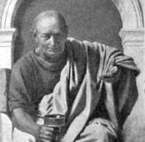


Current Workflow
Raw data files
(≈10⁸ pixels
≈ 0.4GB)
Data Reduction
Visualisation
Quantitative Analysis
Horace
Convert angles to Q
Combines data files
→ 4D S(Q, ω).
(~100-500 files,
~0.1-0.5TB)
Extract 1D cuts / 2D
slices and plots
Algebraic manipulation
Symmetrisation
Evaluate a model on
data coords.
Convolve with simple
functions of (Q, ω).
Fit small cuts / slices
simultaneously
Corrections
Convert to energy
Saves to NXSPE

Slide 4
Bottlenecks
Latest spectrometers at ISIS (LET, MERLIN) create 4D maps of scattering 1 – 2 TB per day
Most functions of the Horace visualisation and analysis code are not parallelised and cannot operate on the latest data volumes.
Modelling codes to quantitatively analyse data are not implemented for high performance computing (HPC), or their output is not integrated into the analysis framework.
Proper account of resolution – whether for powder or single crystal data – is mostly not performed, as current codes are not parallelised and require HPC to be feasible.

Slide 5
Plan
Use STFC DAaaS infrastructure
Parallelise Horace.
Implement & parallelise Tobyfit within Horace
  inc. hybrid McStas/analytical convolution method.
  and powder averaging
Parallelise SpinW.
  Main effort at ESS
Interface to 3rd party modelling codes
GUI workbenches.

Slide 6
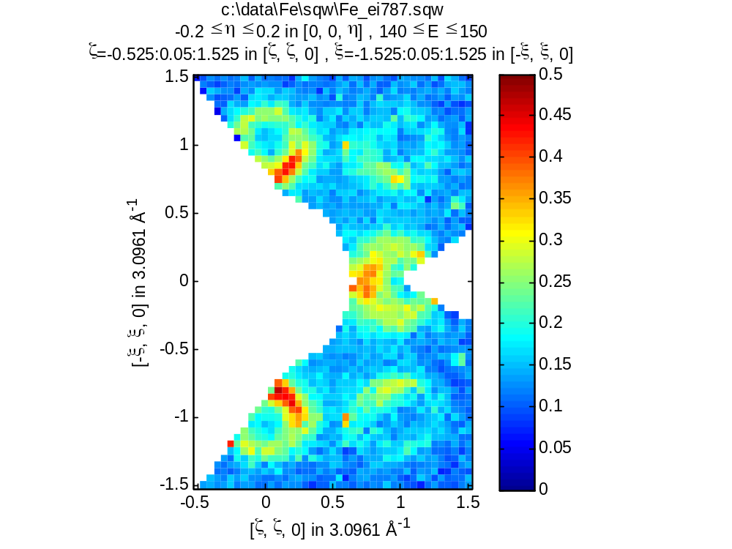
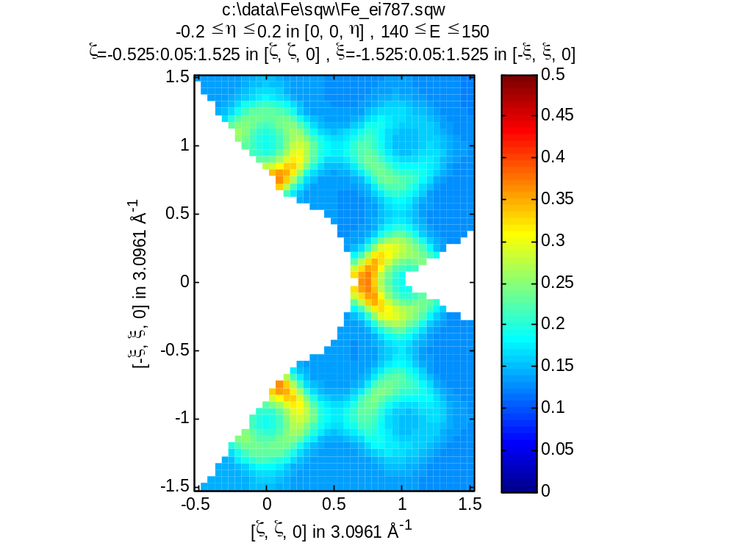
No resolution

Slide 7
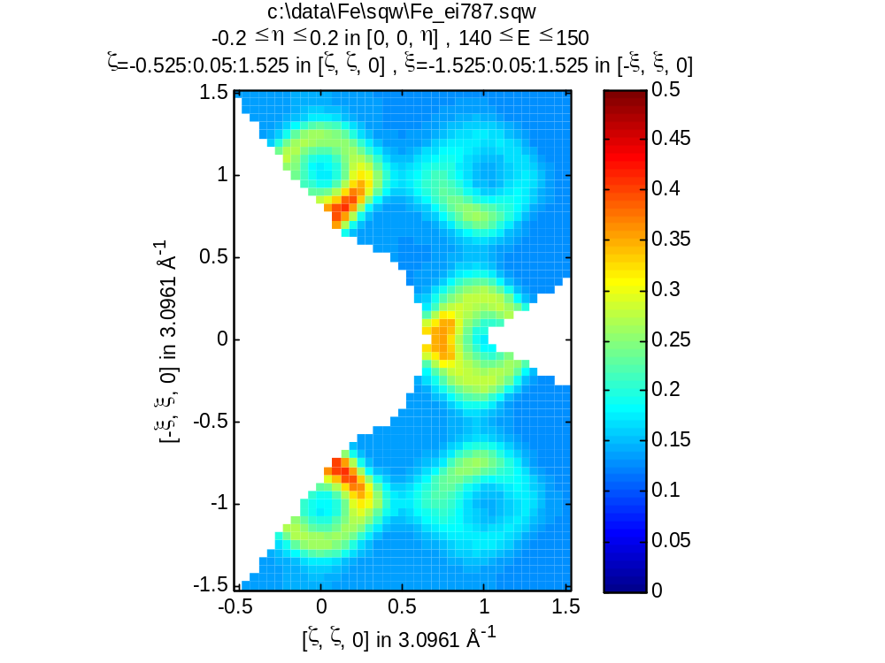
Tobyfit Resolution

Slide 8
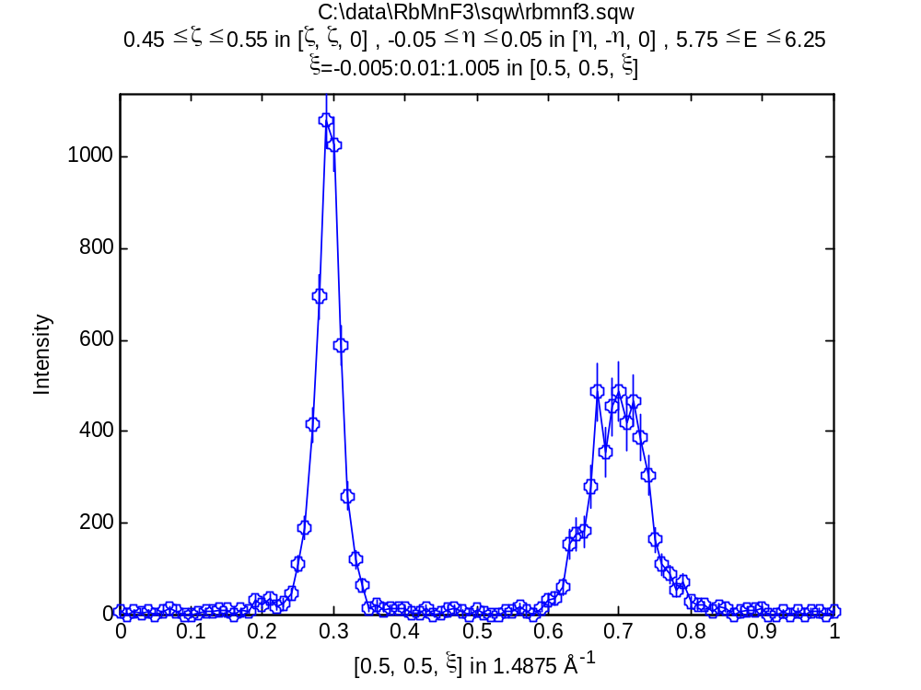
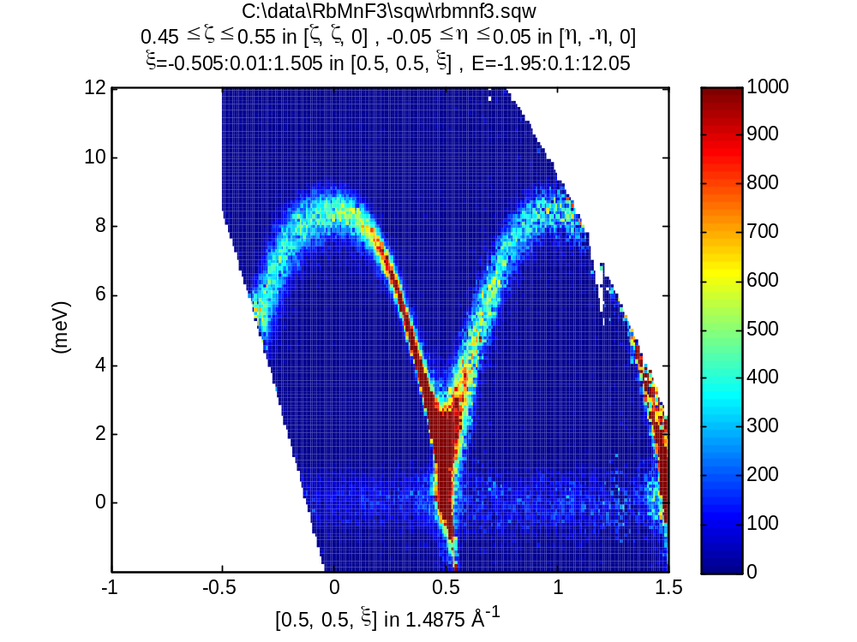
Example – RbMnF₃

Slide 9
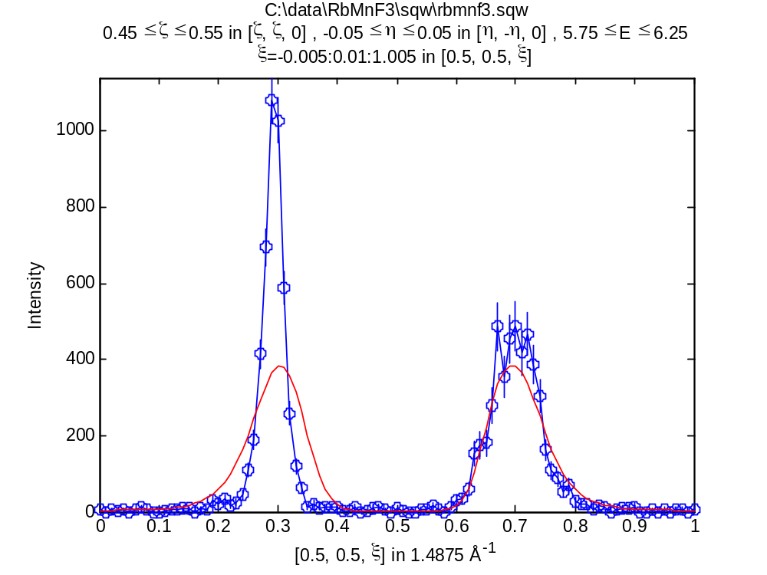
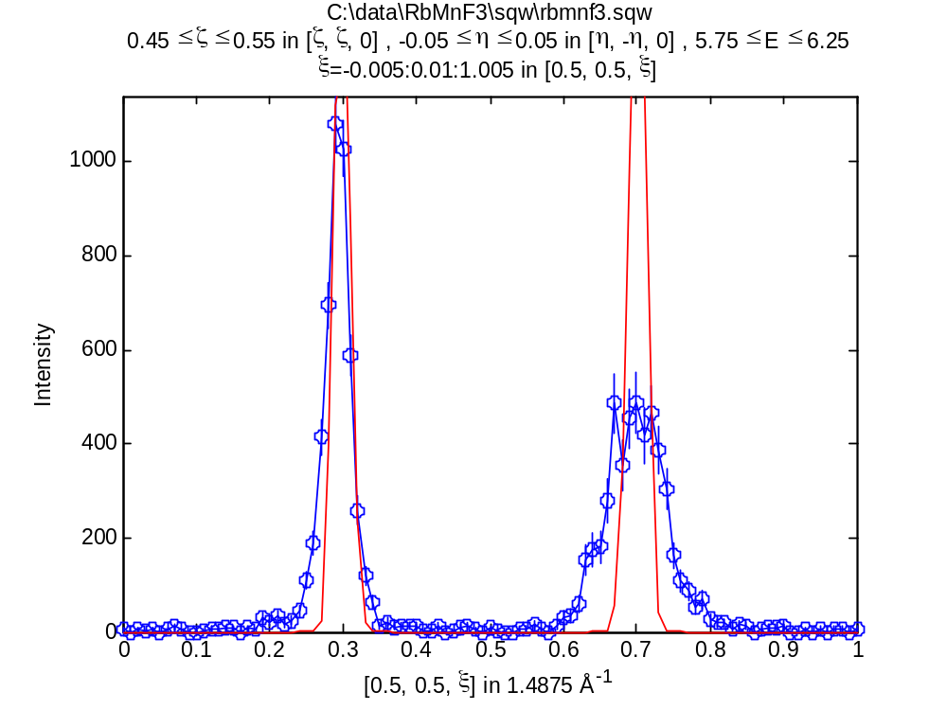
Example – RbMnF₃
Γ = 1 meV
Γ = 0.1 meV

Slide 10
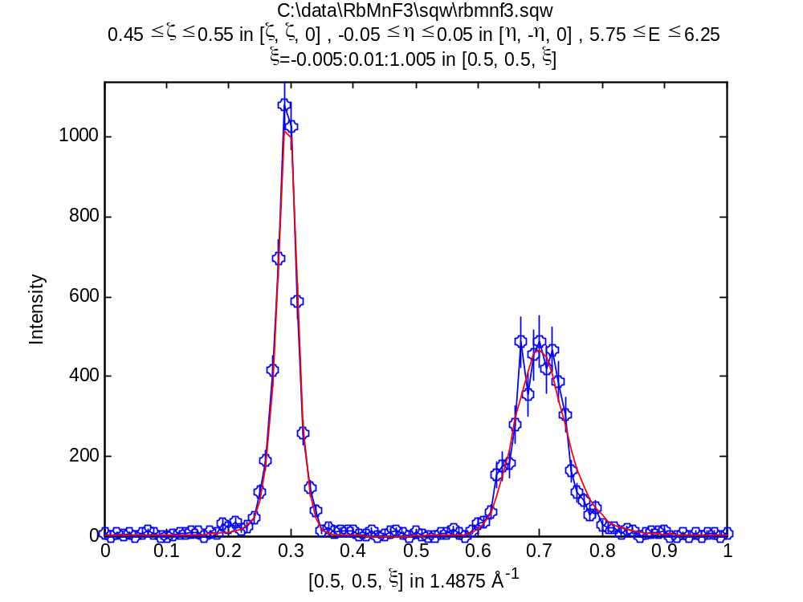
Example – RbMnF₃
Γ = 0.075 ± 0.048 meV
SJ = 8.843 ± 0.016 meV

Slide 11
DAaaS
Data Analysis as a Service
SCD Cloud: 896 cores, 3.5TB
  Provides VMs for user access through VNC/RDP
SCARF: 10280 cores (~3000 ISIS priority)
  Batch system; used for larger jobs.
CernVM-FS (Linux/FUSE)
  Hooks to CEPH/Panasas storage.
  Transparent access to user data.

Slide 12
Project
Budget: £1M over 3 years.
  3 FTE from Scientific Computing (SCD)
  1 FTE from Excitations group (EXC)
    (a new 3-year RA position)
Will have an external project board
Officially starts in April 2018
  Currently working on prototyping and discussions between EXC and SCD

Slide 13
Current Work
User survey
Analysis of the (Horace) framework
  How to parallelise?
  How to allow on-the-fly symmetrisation?
  Flexible detector definition (e.g. per file).
Benchmarking current code.
Initial integration with Castep (phonon)
Exploring how to model resolution of instruments with guides.

Slide 14
Thanks for your attention!

